Slide 1



iFBalance Robot
STEAM AI Education Platform
Shantanu Sen Gupta
Manager, Research Institute
www.koreaits.com
(주)인디프로그

Slide 2

iFBalance
+
AI
Notes:
delete

Slide 3
iFBalance
Contents
iFBalance Components
Environment Setup
RGB LED Control
DC Motor Control
Encoder
Motion Processing Unit (MPU) Sensor
Time of Flight (ToF) Sensor
Proportional, Derivative, and Integral (PID) Control System
IR Sensor Module
Notes:
delete

Slide 4
iFBalance
Day1
- Components - Coding - RGB LED - RTOS
Day 3
- IMU - ToF
Day 4
- PID - IR
Day 2
- Motor - Encoder
Notes:
delete

Slide 5
iFBalance
1.0 Components of iFBalance

Slide 6
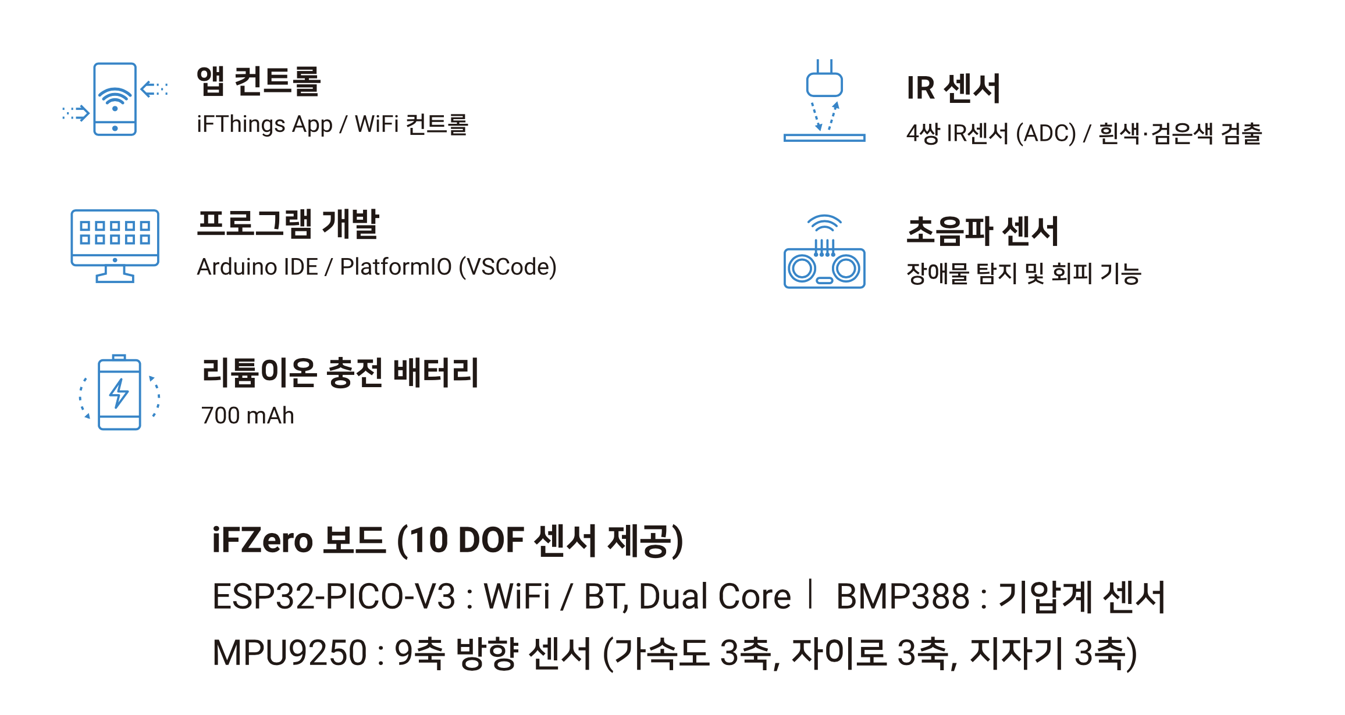
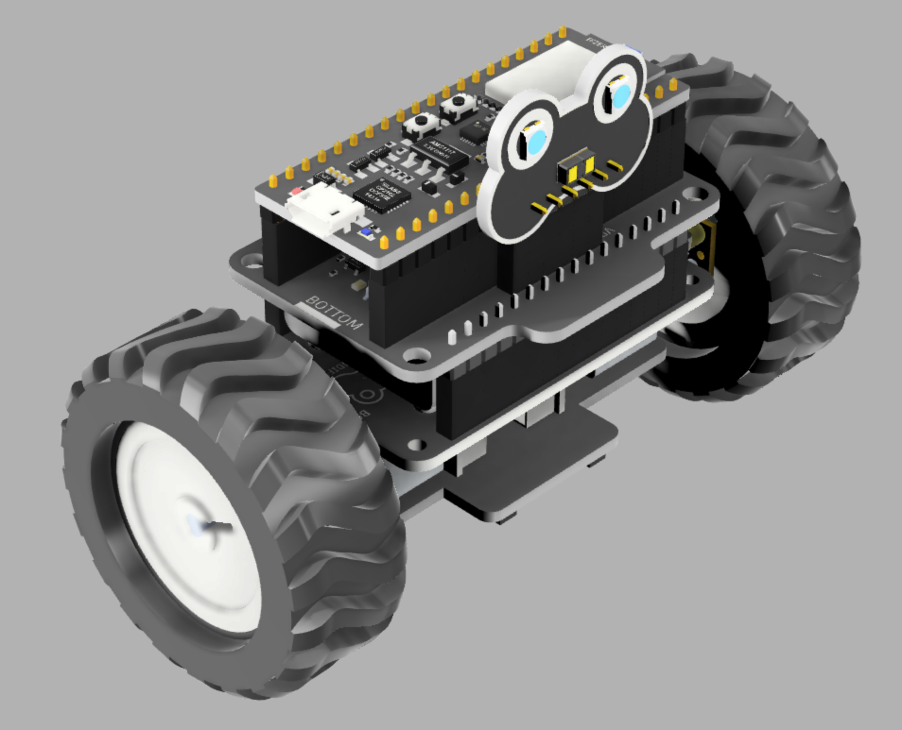


iFBalance
Features

Slide 7
iFBalance

Slide 8
iFBalance
iFZero Module
Notes:
delete

Slide 9
iFBalance
iFThings App
https://play.google.com/store/apps/details?id=com.indifrog.ifthings
https://apps.apple.com/kr/app/ifthings/id1552208956

Slide 10

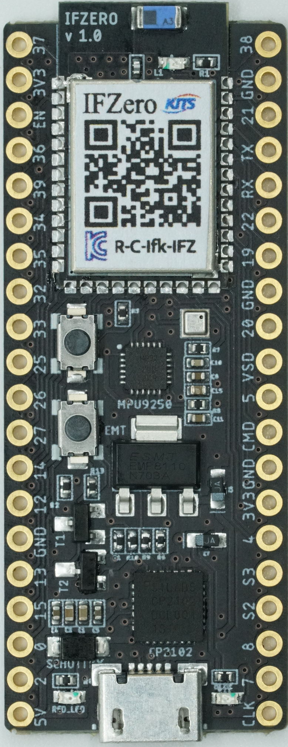
iFBalance
iFZero Board
Development Tools
Arduino
PlatformIO
Native
ESP32 PICO V3
Xtensa® Dual Core 32-bit CPU
WiFi 2.4 GHz
Bluetooth
4 MB Flash Memory
34 programmable GPIOs
12 bit SAR ADC x 18
RTC
BMP388
Pressure Sensor
200 ~ 1250 hPa
30cm Error
I2C
200Hz Sampling
RESET Button
MPU9250
Triple Axis MEMS
Accelerometer 3 Axis
Gyroscope 3 Axis
Magnetometer 3 Axis
400KHz Fast Mode I2C
Digital Motion Processing
GPIO 0 Button
CP2102
USB2Serial
300 ~ 921600 bps

Slide 11
iFBalance
2.0 Environment Setup

Slide 12

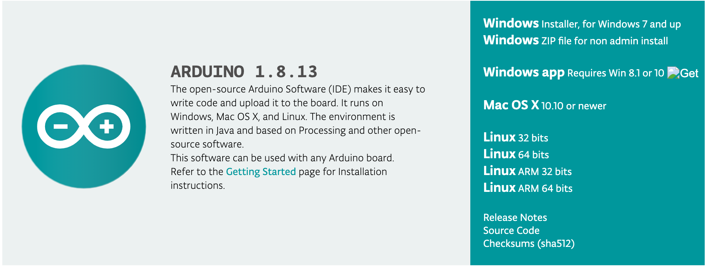
iFBalance
Code it!!
1. Arduino
2. Visual Studio Code
https://www.arduino.cc/en/Main/Software
https://code.visualstudio.com/

Slide 13
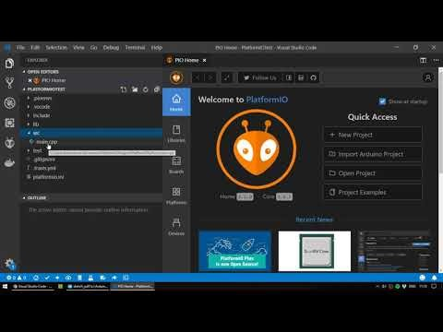
iFBalance
Install Visual Studio Code
&
PlatformIO

Slide 14
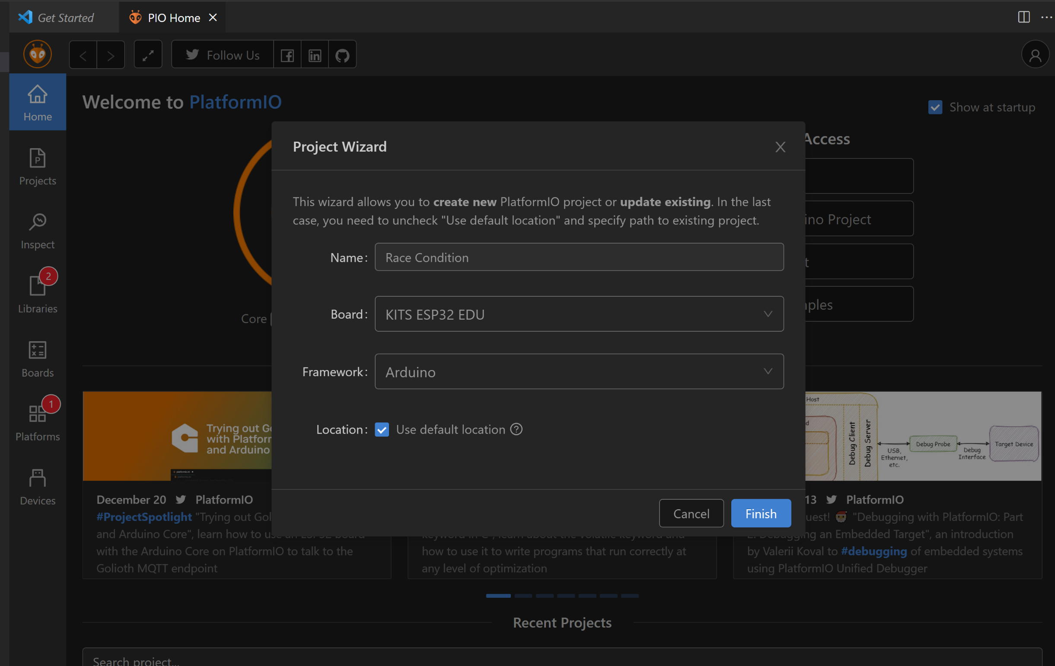
iFBalance
Code in Visual Studio Code
&
PlatformIO

Slide 15
iFBalance
Arduino Code Structure
In ESP-IDF,
void main_app()
In ESP-IDF,
void loopTask()

Slide 16
iFBalance
Add a Library

Slide 17
iFBalance
Configure Platform.ini
[env:pico32]
platform = espressif32
board = pico32
framework = arduino
; ///// 추가함 ////// by serimo 2020.07.25
upload_speed = 921600
monitor_speed = 115200
monitor_port = COM9 ; Windows
; monitor_port = /dev/cu.SLAB_USBtoUART. ; Mac
lib_deps =
# RECOMMENDED
# Accept new functionality in a backwards compatible manner and patches
makuna/NeoPixelBus @ ^2.6.0
# Accept only backwards compatible bug fixes
# (any version with the same major and minor versions, and an equal or greater patch version)
makuna/NeoPixelBus @ ~2.6.0
# The exact version
makuna/NeoPixelBus @ 2.6.0
Automatic

Slide 18
iFBalance
Upload a Program
Serial
Monitor
Upload
Compile

Slide 19
iFBalance
iFZero Board GPIO Connection
IR_LEFT_L
I37
I38
IR_RIGHT_R
3V3
GND
EN
IO21
I2C SDA
IR_CENTER_LB
I36
TX
Battery
I39
RX
IR_CENTER_LF
I34
IO22
I2C SCL
IR_CENTER_RF
I35
IO19
IR_CENTER_C
IO32
GND
IR_LEFT_L IR_CENTER_C IR_RIGHT_R
IR_CENTER_RB
IO33
IO20
IR_TR_1
E_LEFT_A
IO25
VSD
M_RIGHT_B
IO26
IO5
IR_TR_2
IR_CENTER_LB IR_CENTER_RF
M_RIGHT_F
IO27
CMD
E_LEFT_B
IO14
GND
IO12
3V3
GND
IO4
IR_TR_3
IR_CENTER_LF IR_CENTER_RB
E_RIGHT_A
IO13
S3
E_RIGHT_B
IO15
S2
TOF_INT
Button
IO0
IO8
M_LEFT_B
COLOR_LED
IO2
IO7
M_LEFT_F
5V
CLK
IO4 ( BLUE LED )

Slide 20
iFBalance
1st Program
Blink LED
Indigrog Blog (Blink LED Code)

Slide 21
iFBalance
3.0 RGB LED

Slide 22
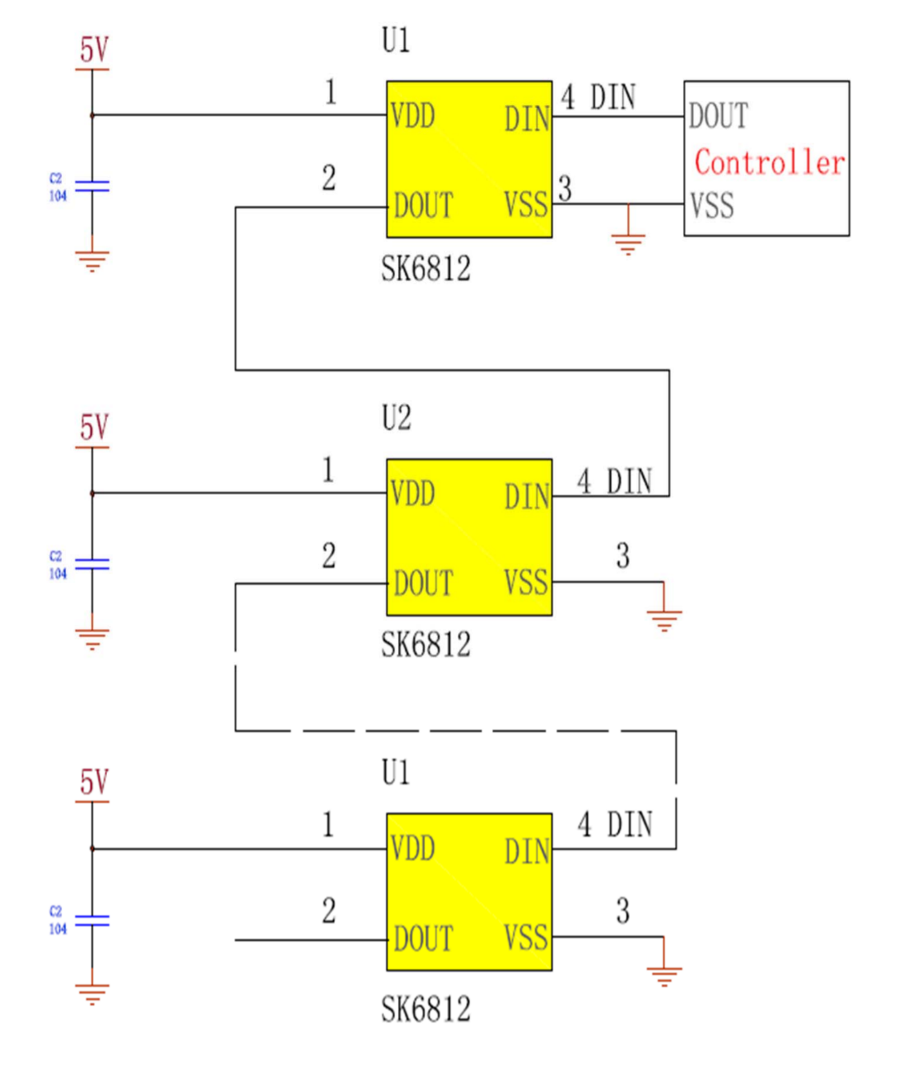
iFBalance
Color LED (SK6812)
In iFBalance
4 RGB LED

Slide 23
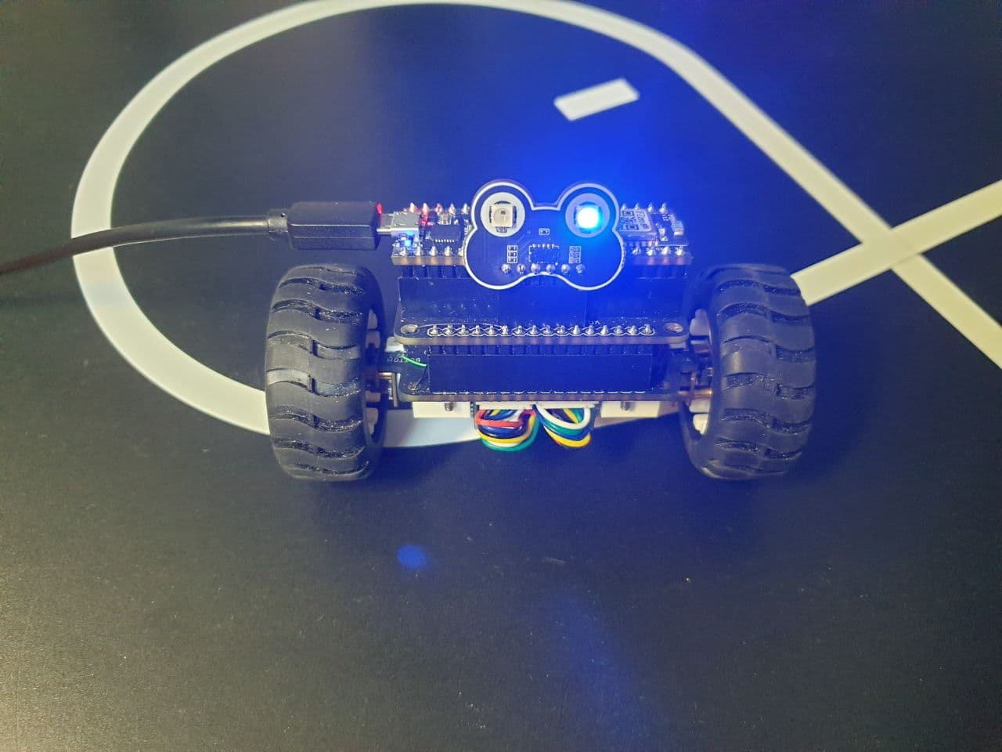
iFBalance
Color LED (SK6812)
LED 3
LED 4
LED 1
LED 2

Slide 24
iFBalance
Color LED (SK6812)
NeoPixelBus
RgbColor red(colorSaturation, 0, 0);
RgbColor green(0, colorSaturation, 0);
RgbColor blue(0, 0, colorSaturation);
RgbColor white(colorSaturation);
RgbColor black(0);
Define Color Brightness
int c = ++nPixel % 4;
strip.SetPixelColor(0, c==0? blue : black);
strip.SetPixelColor(1, c==1? green : black);
strip.SetPixelColor(2, c==2? red : black);
strip.SetPixelColor(3, c==3? blue : black);
strip.Show(); // Send the updated pixel colors to the hardware.
Set color to each LED

Slide 25
iFBalance
2nd Program
Control RGB LED
Indifrog Blog (Control RGB LED)

Slide 26
iFBalance
4.0 Real Time Operating System (RTOS)

Slide 27
iFBalance
Free RTOS
General purpose operating system (GPOS)
√ Windows, Linux, MacOS
√ Not suitable for critical application
√ Variable interrupt latency
√ Not follow programmed priorities strictly
Real time operating system (RTOS)
√ FreeRTOS, Embedded Linux
√ Suitable for critical application
√ Fixed interrupt latency
√ Follow programmed priorities strictly

Slide 28
iFBalance
Free RTOS
Task: set of program instructions loaded in memory
Thread: unit of CPU utilization with its own program counter and stack
Process: instance of a computer program
ESP32 has separate Free RTOS, ESP-IDF Free RTOS
Basic Free RTOS is called Vanilla Free RTOS

Slide 29
iFBalance
Loop
Entry Point (main())
Setup
Task 1
Task 2
Task 3
Loop

Slide 30
iFBalance
Hardware Interrupt
Entry Point (main())
Setup
Task 1
Task 2
Task 3
Interrupt Service Routine
(ISR)
Loop

Slide 31
iFBalance
RTOS
Entry Point (main())
Setup
∞ Task A
∞ Task B
∞ Task C

Slide 32
ESP32 System Architecture
Interrupts
DMA
Interrupts
Embedded
Memory
32KB
32KB
PRO CPU
Core 0
Cache
Core 1
Cache
APP CPU
0
1
MMU
External
Memory
Task A
Scheduler
Peripheral
Scheduler

Slide 33
iFBalance
Free RTOS
Task Scheduling
“Preemptive Scheduling”
ISR
(H/W)
Priority
(S/W)
1
Task B
Task C
Task C
0
Task A
Task A
Task A
Task A
OS
Idle
time

Slide 34
iFBalance
Free RTOS
Create a Task
// Task to be created.
void vTaskCode( void * pvParameters )
{
for( ;; )
{
// Task code goes here.
}
}

Slide 35
iFBalance
Free RTOS
Create a Task
void taskToggleBlueLED(void *pvParameter) {
portTickType delay = *(portTickType*)pvParameter;
digitalWrite(pinBlueLED, LOW);
vTaskDelay(delay/portTICK_PERIOD_MS);
}
non-blocking
1 ms

Slide 36
iFBalance
Free RTOS
Assign a Task
BaseType_t xTaskCreatePinnedToCore (TaskFunction_t pvTaskCode,
const char *constpcName,
const uint32_t usStackDepth,
void *constpvParameters,
UBaseType_t uxPriority,
TaskHandle_t *constpvCreatedTask,
const BaseType_t xCoreID)
pvTaskCode → Pointer to a task function
constpcName → Task name
usStackDepth → Stacksize in bytes
constpvParameters → Parameters to pass in task function
uxPriority → Set priority level
constpvCreatedTask → Task handler of the created task
xCoreID → Core ID where the task will be run

Slide 37
iFBalance
Free RTOS
Assign a Task
xTaskCreatePinnedToCore (taskToggleBlueLED, // function to be called
"Toggle Blue LED",, // name of task
1024, // stack size(in bytes)
(void*)&timeDelay, // param. To pass to function
uxTaskPriorityGet(NULL), //task priority
&TaskHandle, //task handle
0); // core number

Slide 38
iFBalance
Free RTOS
Task States
Create Task
Running
vTaskSuspend()
vTaskResume()
Suspended

Slide 39
iFBalance
Free RTOS
Task States
void vTaskSuspend(TaskHandle_txTaskToSuspend)
Suspend any task. When suspended a task will never get any microcontroller processing time, no matter what its priority.
void vTaskResume(TaskHandle_txTaskToResume)
Resumes a suspended task
void vTaskDelete(TaskHandle_txTaskToDelete)
Remove a task from the RTOS real time kernel’s management. The task being deleted will be removed from all ready, blocked, suspended and event lists
UBaseType_t uxTaskPriorityGet(constTaskHandle_txTask)
Obtain the priority of any task

Slide 40
iFBalance
3rd Program
Play with onboard Blue LED using FreeRTOS
Indifrog Blog (Free RTOS Basic)

Slide 41
iFBalance
Free RTOS
xTaskCreatePinnedToCore( // Use xTaskCreate() in vanilla FreeRTOS
taskToggleBlueLED, // Function to be called
"Toggle BLUE LED", // Name of task
1024, // Stack size (bytes in ESP32, words in FreeRTOS)
(void*)&timeDelay, // Parameter to pass to function
uxTaskPriorityGet(NULL), // Task priority (0 to configMAX_PRIORITIES - 1)
&taskHandle, // Task handle
APP_CPU); // core No.
Blink LED from Protocol CPU

Slide 42
iFBalance
Free RTOS
Blink LED from 2 Tasks
xTaskCreatePinnedToCore( // Use xTaskCreate() in vanilla FreeRTOS
taskToggleBlueLED, // Function to be called
"Toggle BLUE LED", // Name of task
1024, // Stack size (bytes in ESP32, words in FreeRTOS)
(void*)&timeDelay, // Parameter to pass to function
uxTaskPriorityGet(NULL), // Task priority (0 to configMAX_PRIORITIES - 1)
&taskHandle, // Task handle
APP_CPU); // core No.
xTaskCreatePinnedToCore(taskToggleBlueLED2,
"Toggle Blue LED2",
1024,
(void*)&timeDelay2,
uxTaskPriorityGet(NULL),
&taskHandle,
APP_CPU); // change to PRO_CPU. What will happen?

Slide 43
iFBalance
Free RTOS
Race Condition
void incTask(void *parameters) {
int local_var;
while(1) {
local_var = shared_var;
local_var ++;
vTaskDelay(500 / portTICK_PERIOD_MS);
shared_var = local_var;
Serial.println(shard_var);
}
}
Global variable
critical
section

Slide 44
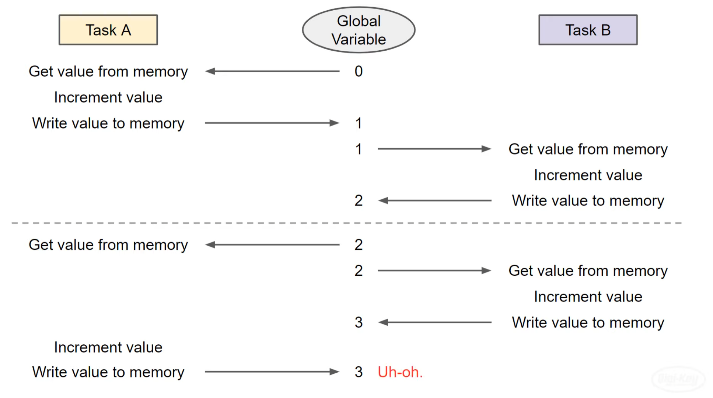
iFBalance
Free RTOS
Before Mutex

Slide 45
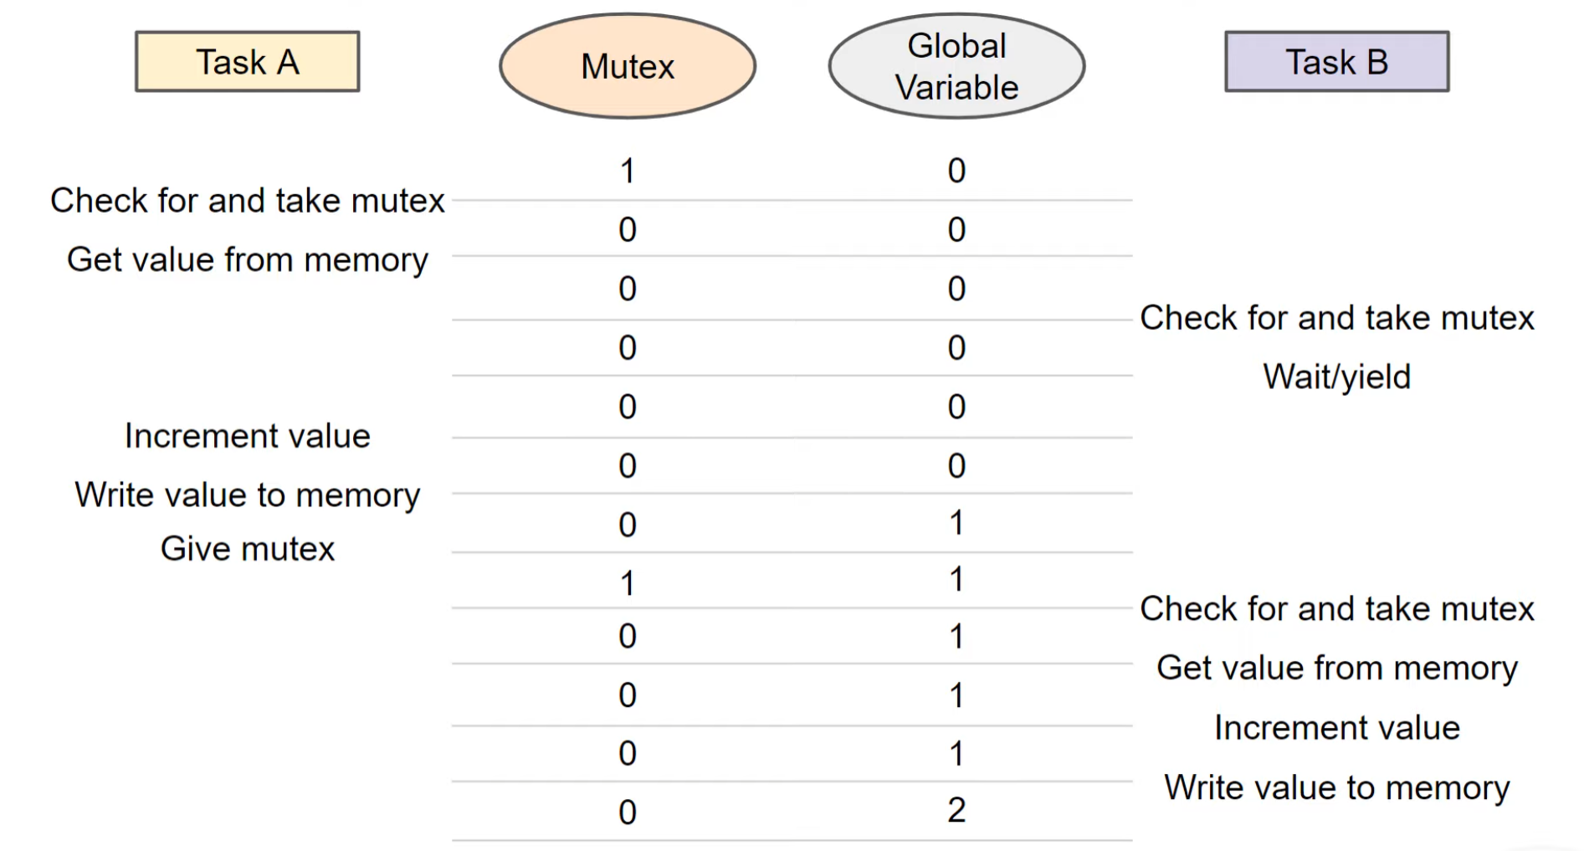
iFBalance
Free RTOS
After Mutex

Slide 46
iFBalance
Free RTOS
MUTEX vs Semaphore
MUTEX | Semaphore
Allows multiple process threads to access a single shared resource but only one at a time | Allows multiple process threads to access the finite instance of the resource until available
For example, a 4kB buffer can be accessed by only one process at a time | For example, a 4 kB buffer can be split into four 1kB buffers. A semaphore can be associated with these four buffers

Slide 47
iFBalance
Free RTOS
MUTEX
xSemaphoreCreateMutex()
Creates a new mutex type semaphore instance, and returns a handle by which the new mutex can be referenced.
xSemaphoreTake(xSemaphore, xBlockTime)
Macro to obtain a semaphore.
xSemaphoreGive(xSemaphore)
Macro to release a semaphore

Slide 48
iFBalance
Free RTOS
Mutual Exclusion (MUTEX)
void incTask(void *parameters) {
int local_var;
while(1) {
// take mutex prior to critical section
if (xSemaphoreTake (mutex, 0) == pdTRUE) {
local_var = shared_var;
local_var ++;
vTaskDelay(500 / portTICK_PERIOD_MS);
shared_var = local_var;
// give mutex prior to critical section
xSemaphoreGive (mutex);
Serial.println(shared_var);
}
}
static SemaphoreHandle_t mutex;

Slide 49
iFBalance
Special Program
Increase a variable from two task

Slide 50
iFBalance
4th Program
Create LED Class
FreeRTOS
Indifrog Blog (iFLED Class for onboard LED)

Slide 51
iFBalance
Free RTOS
Special MUTEX
A spinlock is required in order to prevent multiple CPUs from accessing the same resource concurrently
portENTER_CRITICAL(&spinlock);
// Do something here
portEXIT_CRITICAL(&spinlock);

Slide 52
iFBalance
5th Program
LED, Button
FreeRTOS
Indifrog Blog (HW ISR)

Slide 53
iFBalance
6th Program
LED Blink with Button FreeRTOS
Indifrog Blog (LED Blink with Button FREE RTOS)

Slide 54
iFBalance
7th Program
NeoPixel Class FreeRTOS
Indifrog Blog (iFLED wrapper Class)

Slide 55
iFBalance
5.0 DC Motor Control

Slide 56

iFBalance
DC Motor Working Principle

Slide 57
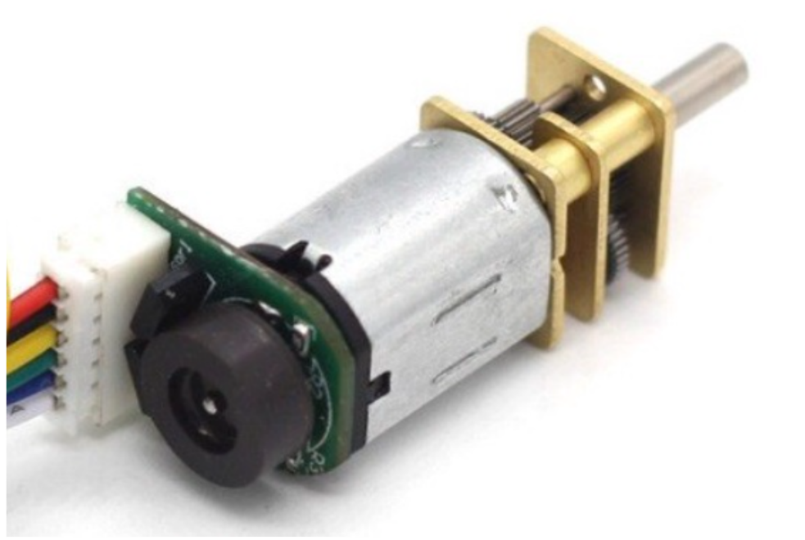
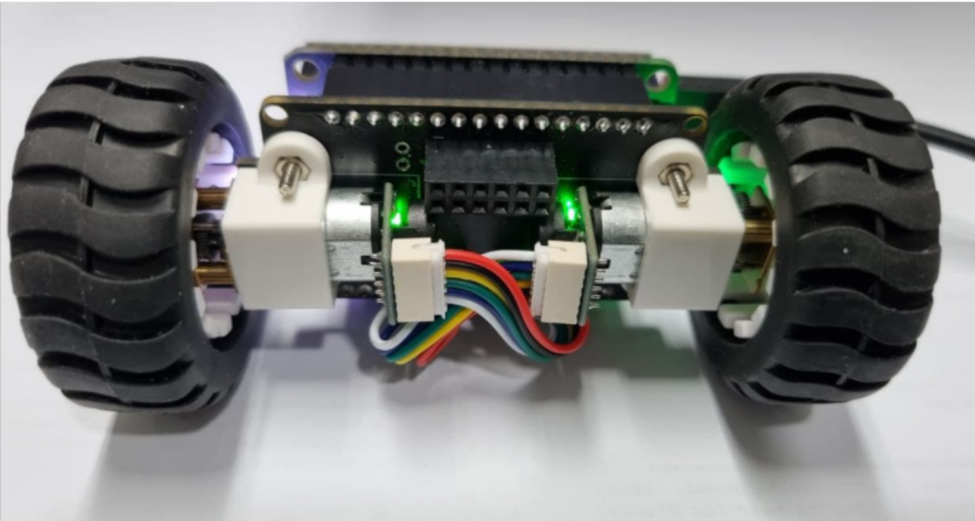
iFBalance
DC Motor
Right Motor
Left Motor

Slide 58
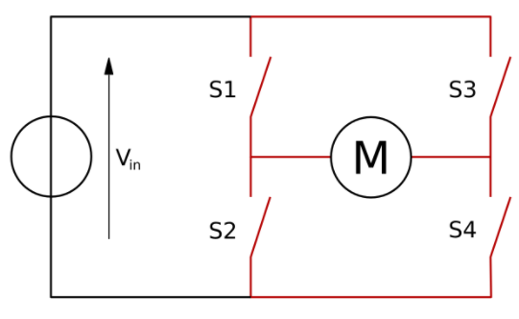
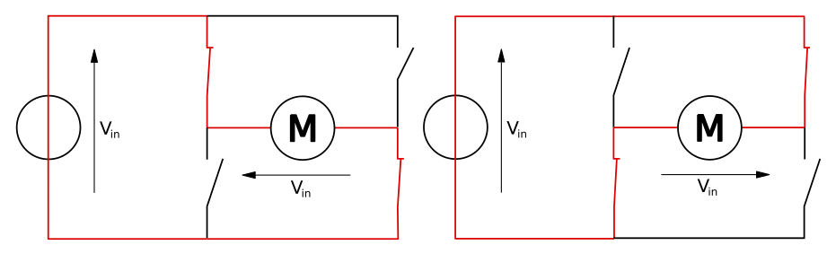
iFBalance
H-Bridge Operation

Slide 59
iFBalance
H-Bridge Operation
S1 | S2 | S3 | S4 | Result
1 | 0 | 0 | 1 | Motor moves right
0 | 1 | 1 | 0 | Motor moves left
0 | 0 | 0 | 0 | Motor Idle
1 | 0 | 0 | 0
0 | 1 | 0 | 0
0 | 0 | 1 | 0
0 | 0 | 0 | 1
0 | 1 | 0 | 1 | Motor brakes
1 | 0 | 1 | 0
× | × | 1 | 1 | Short circuit
1 | 1 | × | ×

Slide 60
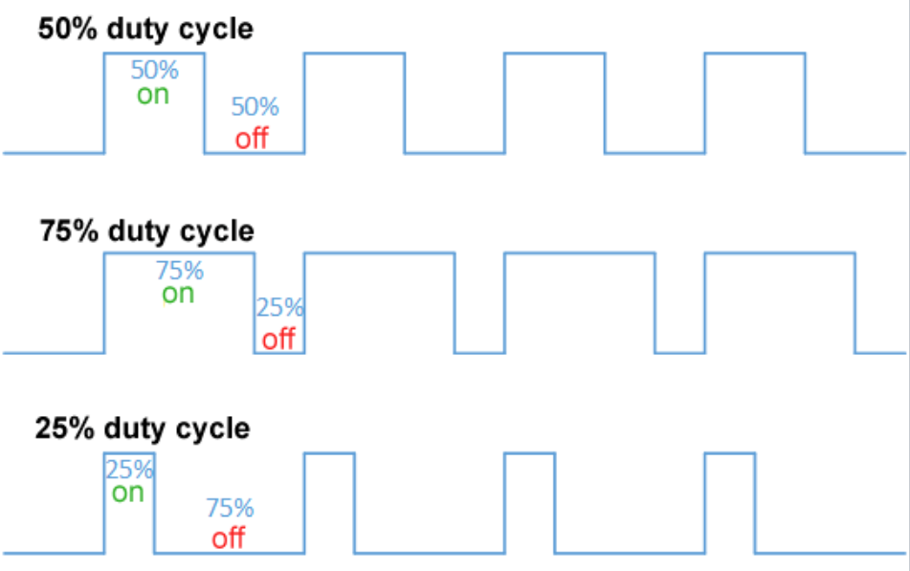
iFBalance
Pulse Width Modulation
(PWM)

Slide 61
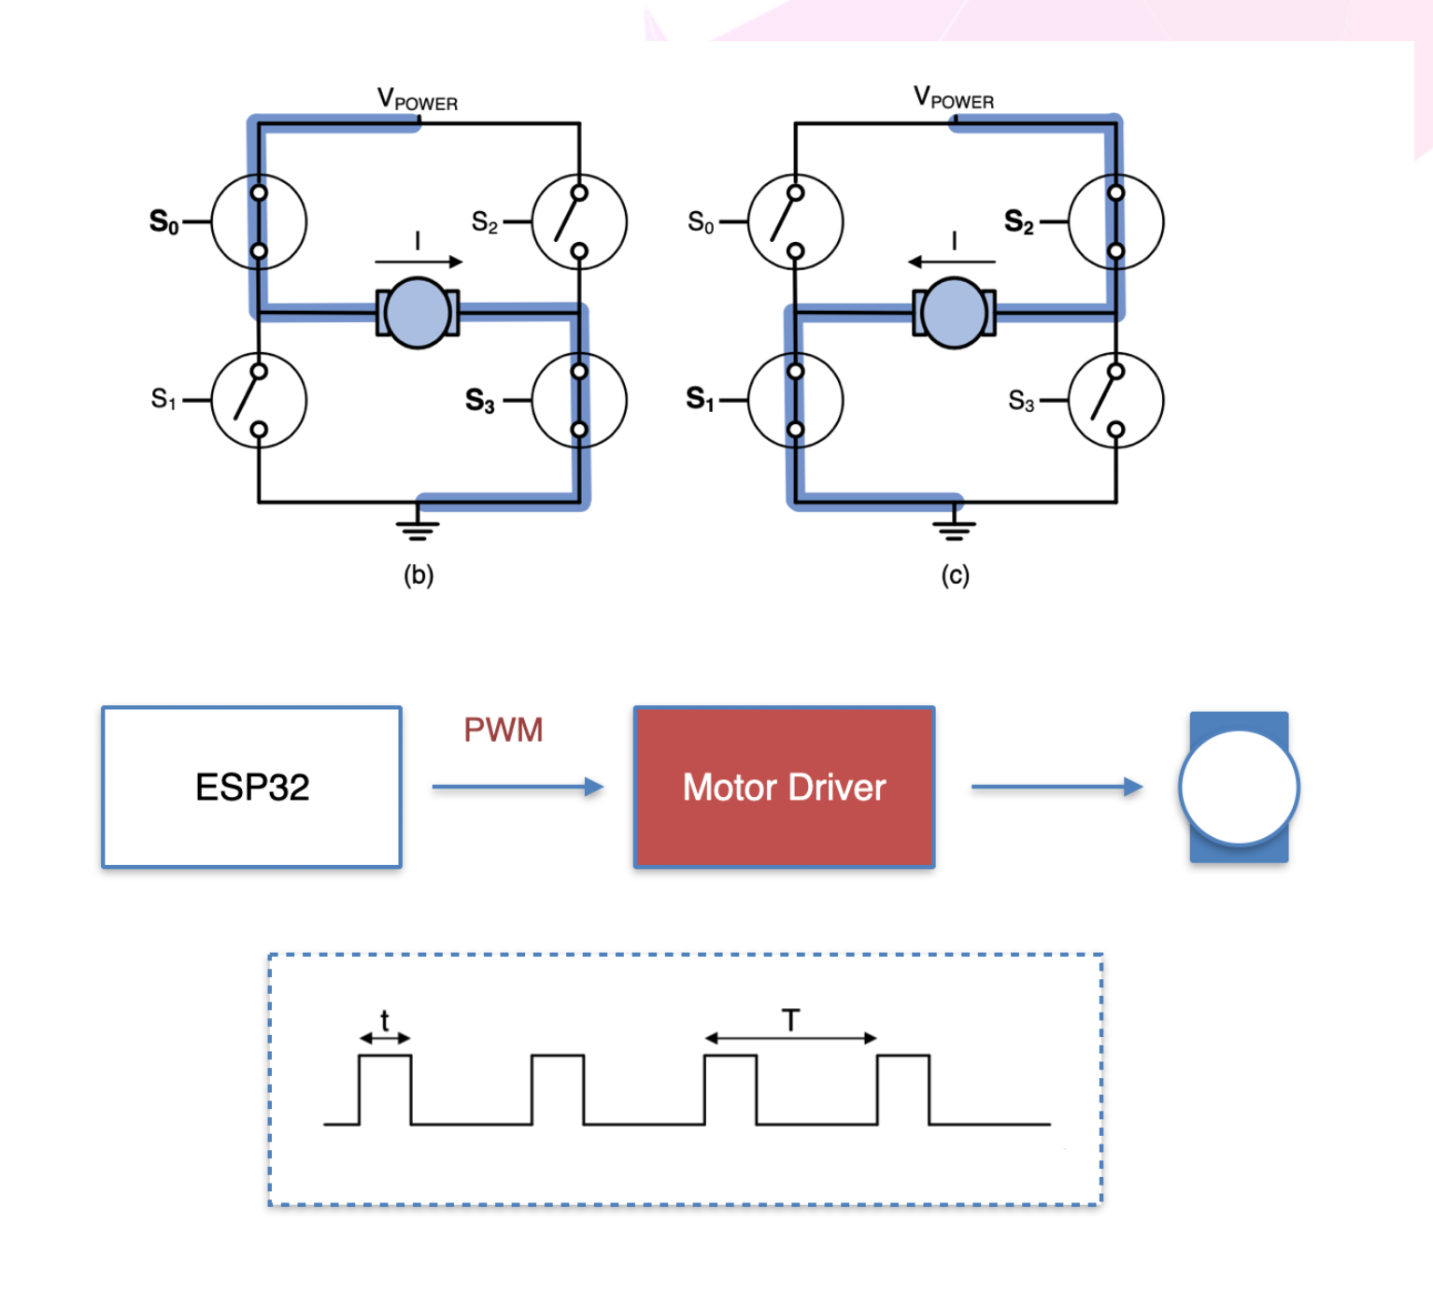
iFBalance
Pulse Width Modulation
(PWM)

Slide 62
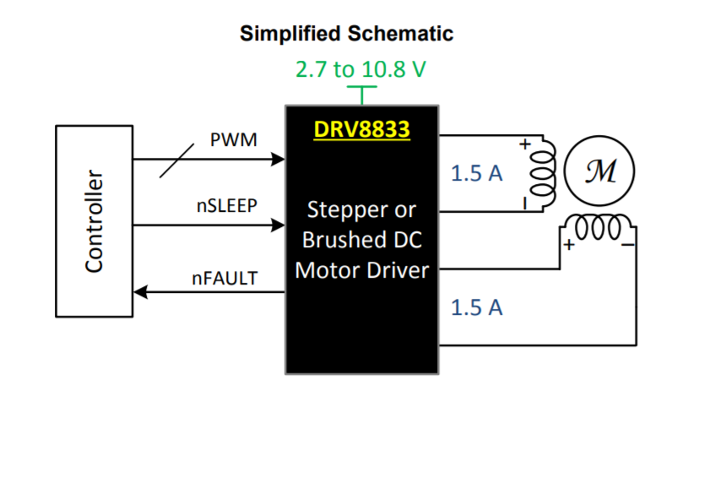
iFBalance
DC Motor Controller
(DRV8833)

Slide 63
iFBalance
DC Motor
Motor Control GPIO
LEFT_WHEEL_FORWARD IO7
LEFT_WHEEL_BACKWARD IO8
RIGHT_WHEEL_FORWARD IO27
RIGHT_WHEEL_BACKWARD IO26

Slide 64
iFBalance
DC Motor
PWM Function in ESP32
ledcSetup(Channel, freq, resolution);
configure PWM functionalitites. 18 channles are available in two ADC group. ADC1_CHx (0~7) & ADC2_CHx (0~9)
Maximum resolution 16 bit.
ledcAttachPin(GPIOPin, Channel);
attach the channel to the GPIO to be controlled
ledcWrite(Channel, dutyCycle);
changing the GPIO output value with PWM

Slide 65
iFBalance
8th Program
Control DC Motor
Indifrog Blog (DC Motor Control)

Slide 66
iFBalance
6.0 Encoder

Slide 67
iFBalance
Encoder
Rotary movements → electrical signals
Absolute encoder | Incremental encoder
Computer mouse wheel, flow meter, conveyor belt, printer

Slide 68
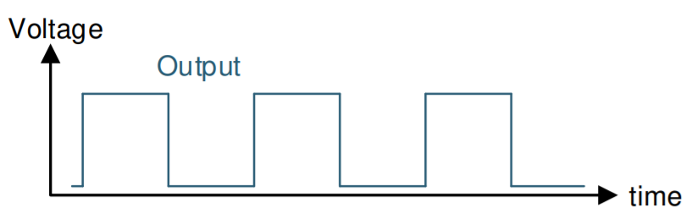
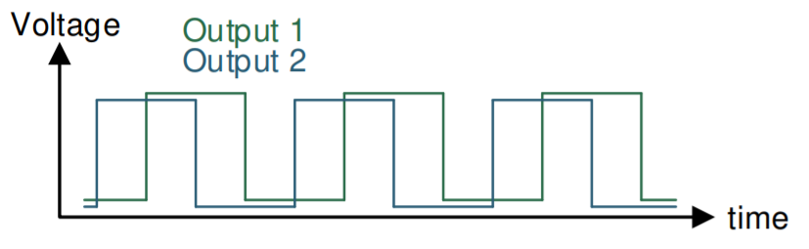
iFBalance
Encoder
Single Output
2-Bit Quadrature Output

Slide 69
iFBalance
Encoder
Technology
Contact
Optical
Inductive
Magnetic

Slide 70
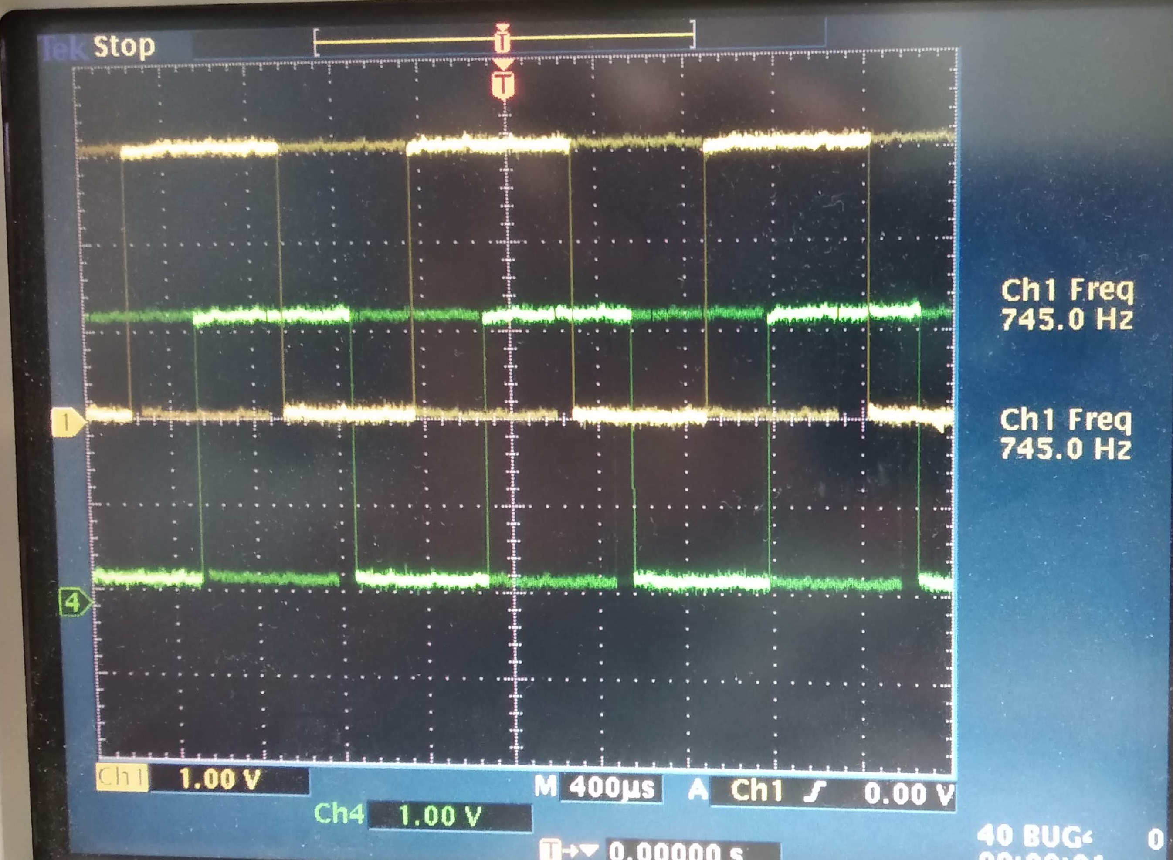
iFBalance
Encoder
Channel A
Channel B
Hall Sensor
N
1
1
0
0
A
1
1
0
0
B
S
Hall Sensor

Slide 71


iFBalance
Encoder
for left motor:
countLeft += (lastLeftA ⊕ newLeftB) – (newLeftA ⊕ lastLeftB)
How to Calculate speed from encoder?
Pin 1 (A) | Pin 2 (B) | Direction
H (Last) | H (Last)
L (New) | H (New) | H⊕H – L⊕H = 0 – 1 = -1
L | L | L⊕L – L⊕H = 0 – 1 = -1
H | L | L⊕L – H⊕L = 0 – 1 = -1

Slide 72
iFBalance
Encoder
Encoder Pin GPIO
LEFT_A IO25
LEFT_B IO14
RIGHT_A IO13
RIGHT_B IO15

Slide 73
iFBalance
Encoder
Interrupt attach to hardware pin
attachInterrupt(m_nLeA, leftISR, CHANGE);
attachInterrupt(m_nLeB, leftISR, CHANGE);
attachInterrupt(m_nReA, rightISR, CHANGE);
attachInterrupt(m_nReB, rightISR, CHANGE);

Slide 74
iFBalance
Encoder
Interrupt Service Routine (ISR)
void IRAM_ATTR iFEncoder::leftISR()
{
bool newLeftB, newLeftA;
portENTER_CRITICAL (& muxl);
newLeftB = digitalRead (m_nLeB);
newLeftA = digitalRead (m_nLeA); countLeft += (lastLeftA ^ newLeftB) - (newLeftA ^ lastLeftB);
if ((lastLeftA ^ newLeftA) & (lastLeftB ^ newLeftB)) {
errorLeft = true;
}
lastLeftA = newLeftA;
lastLeftB = newLeftB;
portEXIT_CRITICAL(&muxl);
}

Slide 75
iFBalance
9th Program
Calculate speed from encoder output
Indifrog Blog (Encoder)

Slide 76
iFBalance
6. Motion Processing Unit (MPU)

Slide 77
iFBalance
INS ( Inertial Navigation System )
GPS ( Global Positioning System )
Barometer
ToF
UltraSonic
Lidar
Optical Flow
BMP388
VL53L3CX
Altimeter
AHRS
MRAG
( Attitude & Heading Reference System )
( Magnetic, Anglear Rate, Gravity )
MPU9250
IMU
Compass
( Inertial Measurement Unit )
+
Accelerometers
Gyroscopes
Magnetometers
iFBalance

Slide 78
iFBalance
MPU9250 : IMU Sensor
6 axis IMU(Inertial Measurement Unit) sensor(Accelerometers, Gyroscopes) : MPU6500
3-Axis Magnetometers Sensor : AK8963
Operates at 3.3V
I2C, SPI support
Application
AHRS(Attitude & Heading Reference System) 혹은 MARGS(Magnetic, Angular Rate, Gravity)
DMP(Digital Motion Processing)
Digital Compass
Notes:
Roll direction change from original blog

Slide 79
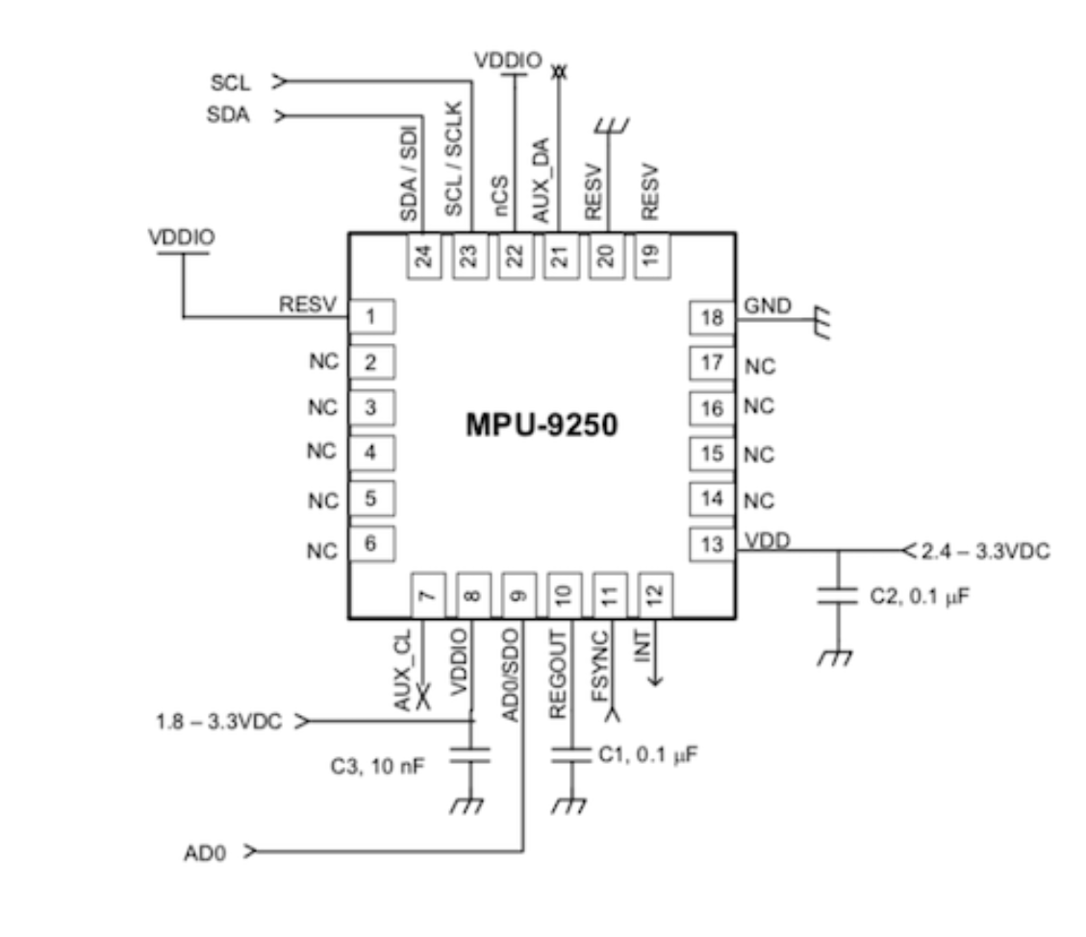
iFBalance
MPU9250 : IMU Sensor

Slide 80
iFBalance
MPU9250 : IMU Sensor
MPU Pin GPIO
I2C SDA IO21
I2C SCL IO22
MPU9250 Interrupt IO5

Slide 81
iFBalance
Accelerometer
Digital-output triple-axis accelerometer with a programmable full scale
range of ±2g, ±4g, ±8g and ±16g and integrated 16-bit ADCs
Accelerometer normal operating current: 450µA
Low power accelerometer mode current: 8.4µA at 0.98Hz, 19.8µA at
31.25Hz
Sleep mode current: 8µA
User-programmable interrupts
Wake-on-motion interrupt for low power operation of applications
processor
Self-test

Slide 82
iFBalance
Gyroscope
Digital-output X-, Y-, and Z-Axis angular rate sensors (gyroscopes) with a
user-programmable full scale range of ±250, ±500, ±1000, and ±2000°/sec and integrated 16-bit ADCs
Digitally-programmable low-pass filter
Gyroscope operating current: 3.2mA
Sleep mode current: 8µA
Factory calibrated sensitivity scale factor
Self-test

Slide 83
iFBalance
Magnetometer
3-axis silicon monolithic Hall-effect magnetic sensor with magnetic concentrator
Wide dynamic measurement range and high resolution with lower current
consumption.
Output data resolution of 14 bit (0.6µT/LSB)
Full scale measurement range is ±4800µT
Magnetometer normal operating current: 280µA at 8Hz repetition rate
Self-test function with internal magnetic source to confirm magnetic sensor operation
on end products

Slide 84
iFBalance
Roll, Pitch, Yaw (rpy)
Yaw
Roll
Pitch

Slide 85

iFBalance
Roll, Pitch, Yaw
Pitch + Offset
Yaw
0
Setpoint
Pitch
Back
Front
Roll

Slide 86
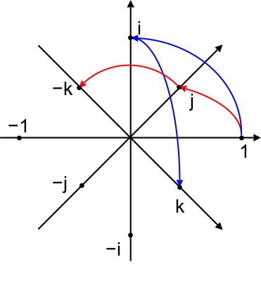
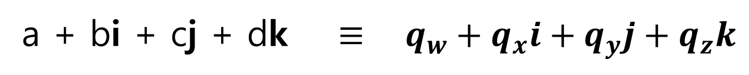
iFBalance
Quaternion
a + bi + cj + dk $≡ q_{w}+q_{x}i+q_{y}j+q_{z}k$

Slide 87
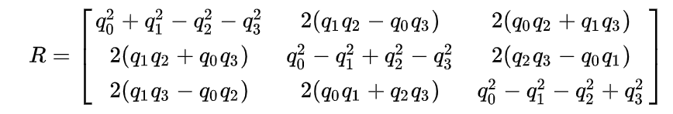

iFBalance
Rotation Matrix from Quaternion
$$Let,$$
$$q_{0}=q_{w}$$
$$q_{1}=q_{x}$$
$$q_{2}=q_{y}$$
$$q_{3}=q_{z}$$

Slide 88
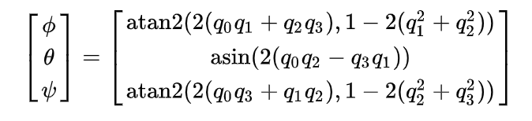

iFBalance
From Quaternion to Euler Angle
Roll
Pitch
Yaw
$$Let,$$
$$q_{0}=q_{w}$$
$$q_{1}=q_{x}$$
$$q_{2}=q_{y}$$
$$q_{3}=q_{z}$$

Slide 89
iFBalance
Roll, Pitch, Yaw
(Flow Chart)
Update Accelerometer
Update Gyroscope
Update Magnetometer
Quaternion Filter
(MAHONY / MADGWICK / No Filter)
Rotation Matrix
Euler Angle

Slide 90
iFBalance
10th Program
Accelerometer, Gyroscope, & Magnetometer data from MPU9250
Indifrog Blog (MPU 9250)

Slide 91
iFBalance
7. Time of Flight (ToF) Sensor

Slide 92
iFBalance
Time of Flight (ToF)
Field-of-View (FoV): 25 °
Time-of-Flight (ToF)
IR ranging sensor
2 Meter
I2C

Slide 93
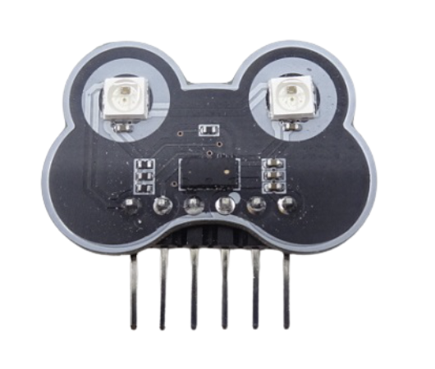
VL53L3CX
FoV 25º
Multi Target Detection
300+ mm Detection

Slide 94
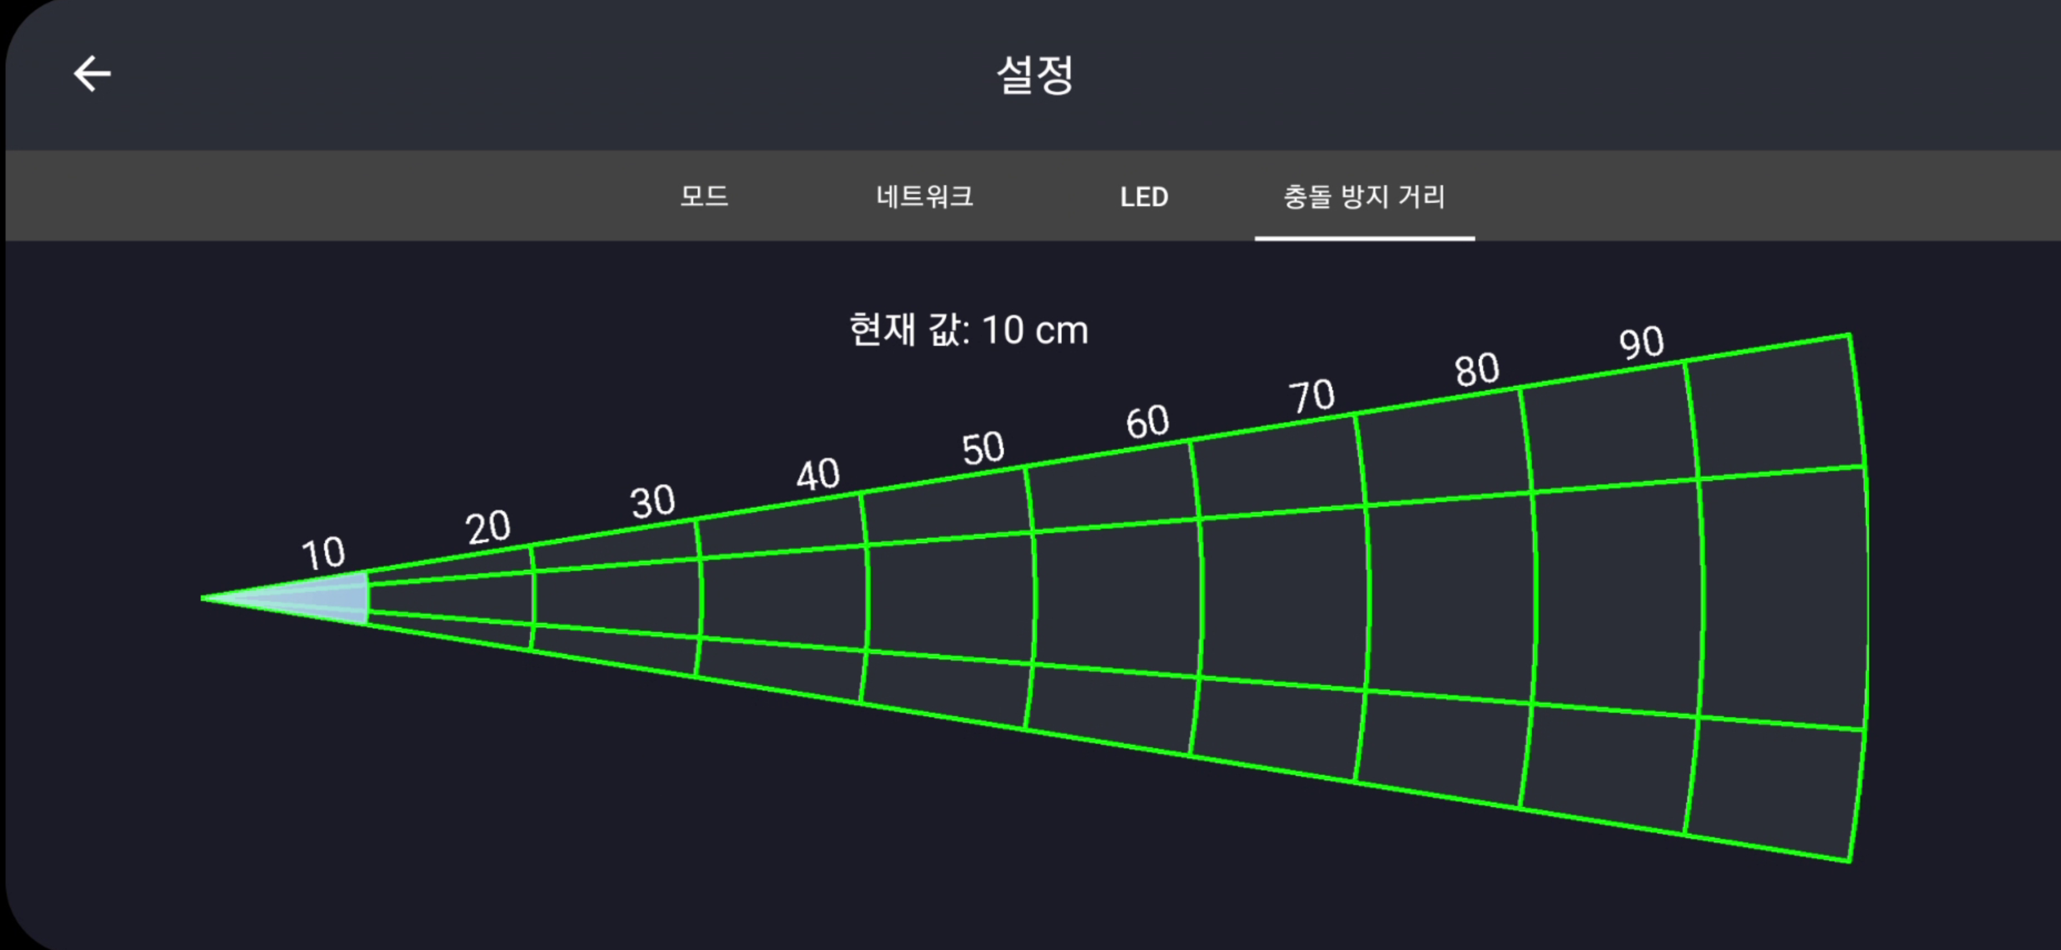
iFBalance
VL53L3CX

Slide 95
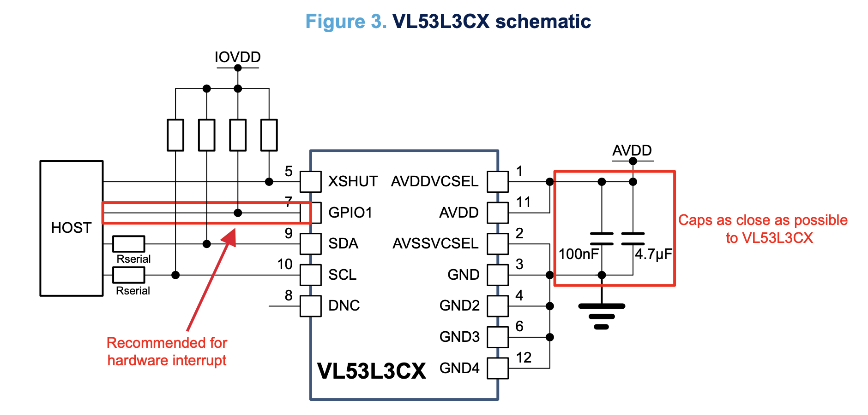
VL53L3CX
Chip On/Off

Slide 96
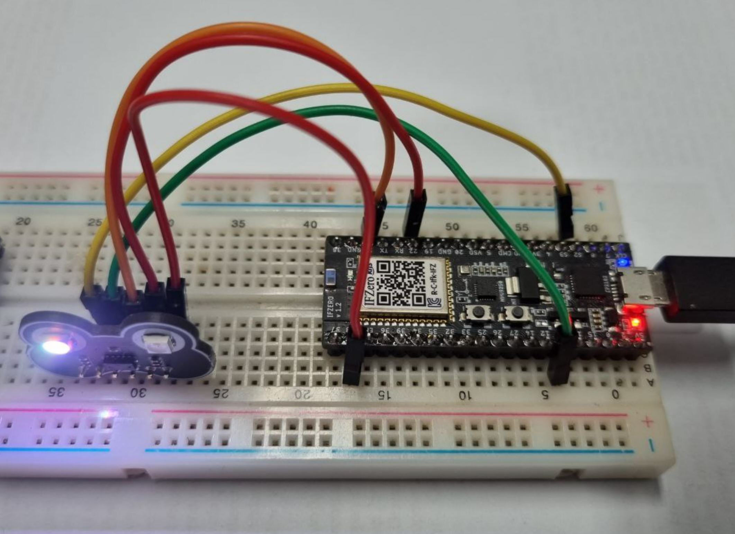
VL53L3CX

Slide 97
iFBalance
12th Program
Measure Obstacle Distance Using
ToF Sensor
Indifrog Blog (ToF Sensor)

Slide 98
VL53L3CX
./.pio/libdeps/pico32/STM32duino/VL53L3CX/src/vl53lx_class.h
// VL53LX(TwoWire *i2c, int pin) : RangeSensor(), dev_i2c(i2c), gpio0(pin)
// {
// Dev = &MyDevice;
// memset((void *)Dev, 0x0, sizeof(VL53LX_Dev_t));
// MyDevice.I2cHandle = i2c;
// MyDevice.I2cDevAddr = VL53LX_DEFAULT_DEVICE_ADDRESS ;
// }
VL53LX() : RangeSensor()
{
dev_i2c = &Wire;
gpio0 = -1;
Dev = &MyDevice;
memset((void *)Dev, 0x0, sizeof(VL53LX_Dev_t));
MyDevice.I2cHandle = dev_i2c;
MyDevice.I2cDevAddr = VL53LX_DEFAULT_DEVICE_ADDRESS ;
}

Slide 99
VL53L3CX
./.pio/libdeps/pico32/STM32duino/VL53L3CX/src/vl53lx_class.h
VL53LX_Error InitSensor(uint8_t address)
{
VL53LX_Error status = VL53LX_ERROR_NONE;
//comment
// VL53LX_Off();
// VL53LX_On();
VL53LX_software_reset();
status = VL53LX_SetDeviceAddress(address);
…………………………..

Slide 100
iFBalance
Special Program
Conflict between two I2C Device
Indifrog Blog (I2C Devices Conflict)

Slide 101
iFBalance
8. Proportional Integral Derivative (PID)

Slide 102
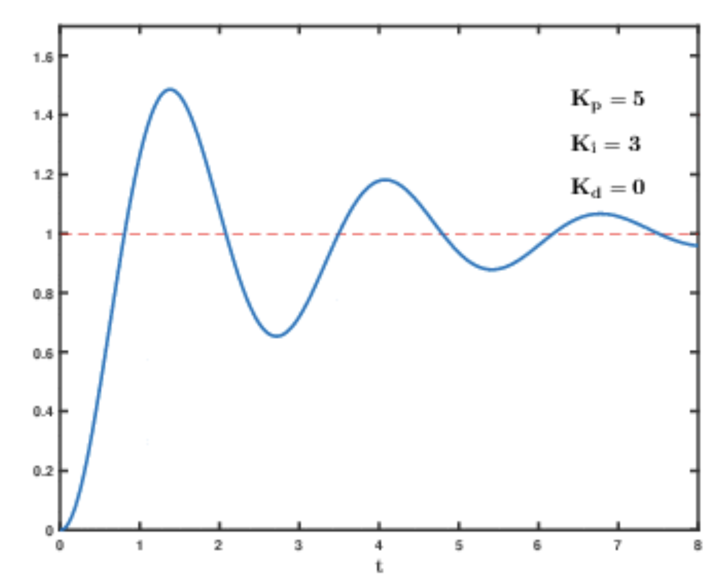

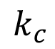

iFBalance
PID Control
Proportional
$$k_{p}$$
Integration
$$k_{c}$$
Differentiation
$$k_{d}$$

Slide 103
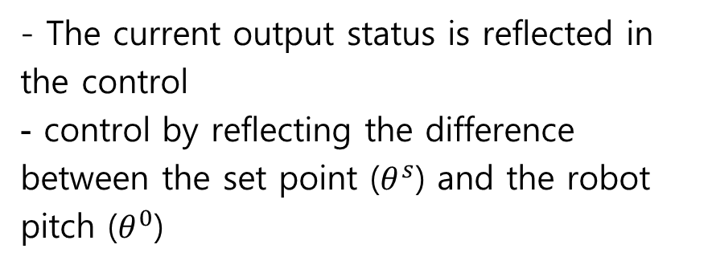
iFBalance
Opened Loop Control
Closed Loop Control
- The current output status is reflected in the control
control by reflecting the difference between the set point ($θ^{s}$) and the robot pitch ($θ^{0}$)
- It does not reflect the current output status
Reference
Error
Control signal
Output
r(t)
u(t)
y(t)
r(t)
e(t)
u(t)
y(t)
Controller
Process
Controller
Process
Sensor
Measured value

Slide 104
iFBalance
PID Control
Proportional
∝ error
Integration
steady state error
Differentiation
Overshoot Stability

Slide 105
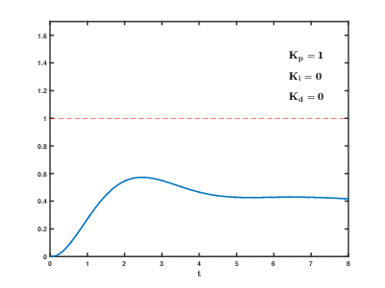
iFBalance
PID Control
GIF credit: https://commons.wikimedia.org/wiki/File:PID_Compensation_Animated.gif

Slide 106
iFBalance
PID Control
Set $k_{p}$
Set 𝑘_𝑝
Set $k_{i}$ & $k_{d}$ = 0
Set 𝑘_𝑖 & 𝑘_𝑑 = 0
Set $k_{i}$
Set 𝑘_𝑖
Fixed $k_{p}$
Fixed 𝑘_𝑝
Set $k_{d}$
Set 𝑘_𝑑
Fixed $k_{p}$ & Fixed $k_{i}$
Fixed 𝑘_𝑝 & Fixed 𝑘_𝑖
Start from (–) pitch value
Stop at (+) pitch value
Increase $k_{p}$
Increase 𝑘_𝑝
$k_{p}$ is set0
𝑘_𝑝 is set0
Increase $k_{i}$
Increase 𝑘_𝑖
Pitch repeats between (+) & (-)
Stop $k_{i}$ at uniform vibration
Stop 𝑘_𝑖 at uniform vibration
Stop at minimum overshoot

Slide 107
iFBalance
PID Controller
Proportional
P
Reference
Integral
PWM Motor Control
r(t)
u(t)
y(t)
Setpoint
e(t)
I
Process
Pitch
Differential
D
Measured value
IMU Sensor

Slide 108
iFBalance
PID Control
Proportional
Integral
Differential
Output
0
Pitch + Offset
Setpoint
System Variable
System
Back
Front
P
IMU Sensor
PWM Motor Control
Setpoint
Input
Error
I
Output
Measurement
Pitch
D
Time Interval ( Unit : Second ) : 0.005 sec

Slide 109
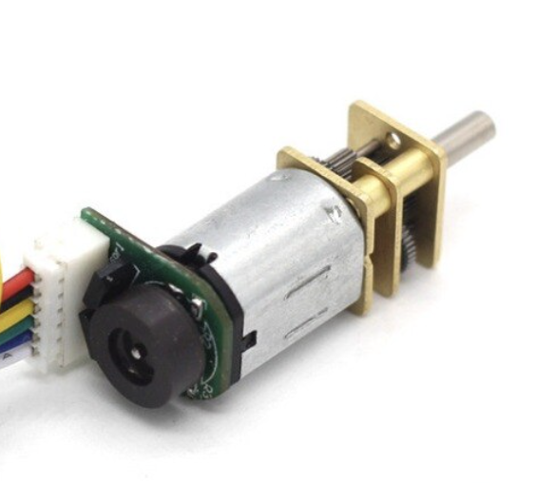
iFBalance
System
Left
Setpoint
Input
PID
Output
Mixer
Measurement
Right
Pitch

Slide 110
iFBalance
System
Pitch
Setpoint
Input
PID
Output
Measurement
Setpoint
Input
PID
Output
Measurement
Pitch

Slide 111
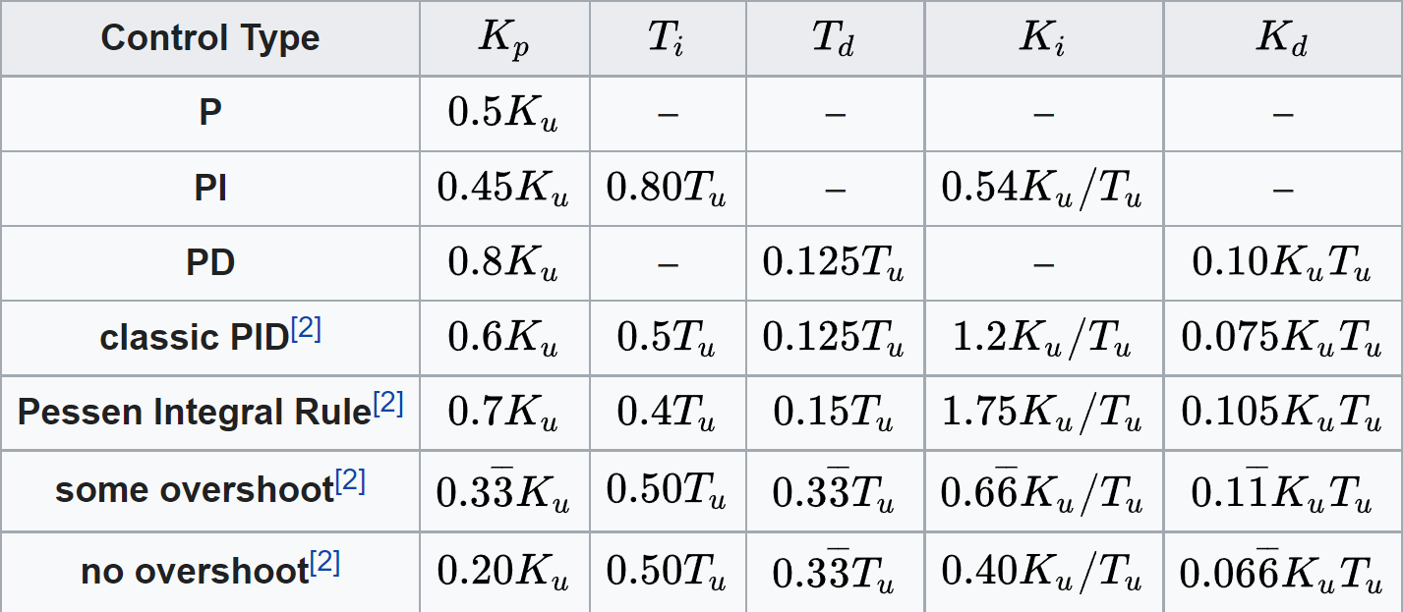
iFBalance
PID Control
Ziegler–Nichols method
 Heuristic PID control method
https://en.wikipedia.org/wiki/Ziegler%E2%80%93Nichols_method

Slide 112
iFBalance
PID Control
Pitch Value from IMU
Level PID
Pitch Value
+
Gyrosensor value
from IMU
Rate PID

Slide 113
iFBalance
11th Program
Speed control with PID
Indifrog Blog (PID)

Slide 114
9. IR Sensor Module

Slide 115
ESP32 ADC (Group 1)
ADC1 Channels GPIO
Channel 0 IO36
Channel 1 IO37
Channel 2 IO38
Channel 3 IO39
Channel 4 IO32
Channel 5 IO33
Channel 6 IO34
Channel 7 IO35

Slide 116
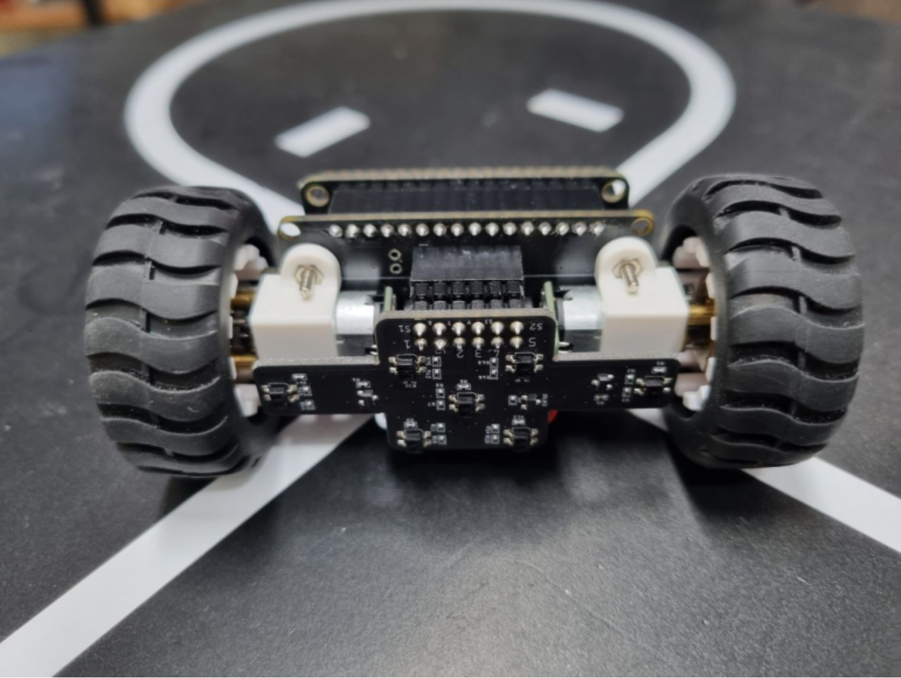
IR Sensor Position
Right Font
Left Front
Left Most
Right Most
Left Back
Right Back
Center

Slide 117
IR Sensor Pair → GPIO
Sensor Location GPIO
Left Most (LL) GPIO5
Center (CC) GPIO5
Right Most (RR) GPIO5
Left Back GPIO4
Right Front GPIO4
Left Front GPIO20
Right Back GPIO20
Group 1
Group 2
Group 3

Slide 118
iFBalance
13th Program
Read IR Sensor Module
Indifrog Blog (IR Sensor)

Slide 119
iFBalance
Line Track Specification and IR Sensor Placement
1cm
https://blog.naver.com/serimo/222007740015

Slide 120
iFBalance
Our Website https://www.indifrog.co.kr/
Find Indifrog at Naver Blog
Find Indifrog at Instagram
Find Indifrog at Youtube
Find INDIFROG at Facebook

